Slide 1
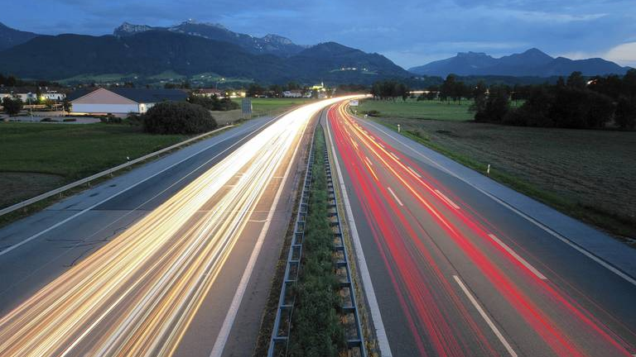

Autobahn
Traffic sign classification
Paul, Georg, 이장호, 이주현, 이지은
Notes:
Hello
We're the Autobahn team who will be presenting on the topic of road traffic sign classification.

Slide 2
Content
Project introduction
What is YOLO?
Reference Paper
Data labeling
Implementation
Result
Notes:
Project introduction : 30s~1m /지은
What is YOLO? : 1~2m / paul
Reference Paper : 2m /장호
Data labeling : 1m /georg -> upload labeling please
Implementation : 2~3m /주현
Result : 1~2m /지은
The table of contents is as follows.
First, we will introduce the project and the model we used, and we will show you the reference thesis and data labeling process.
Finally, we'll show you how we implemented it and what we've achieved.
목차는 다음과 같습니다.
먼저, 프로젝트에 대한 소개와 저희가 사용한 모델에 대해 소개해드릴 예정이고, 참고한 논문 및 데이터 라벨링 과정을 보여드릴 예정입니다.
마지막으로는 구현한 방법과 결과물에 대해 보여드리겠습니다.

Slide 3
Project introduction
Traffic Sign Classifier
: Traffic Sign detection and classification from real time data input
1. Traffic Sign Data acquisition
2. Select Deep Learning Model
3. Labeling Data
4. Train Model
5. Evaluate Model
Notes:
First, I will give you a brief introduction to the project. Our team carried out a project to detect and classify traffic signs in real time driving videos.
We acquired traffic sign data and labeled the data. For our deep learning model we used the YOLO algorithm. After training the model with our data we evaluated the performance of the model.
먼저 프로젝트에 대한 간단한 소개를 해드리겠습니다. 저희 팀은 도로주행 영상 속에 있는 교통 표지판을 탐지하여 분류하는 프로젝트를 진행하였습니다.
교통 표지판 데이터를 획득하고 딥러닝 모델을 정하고 데이터를 라벨링하였습니다. 그 후 모델을 학습시키고 평가하는 시간을 가져보았습니다.
//
주행영상 속의 도로 교통 표지판을 detect하고 classification하기
데이터 습득
모델 선정
라벨링
학습
평가

Slide 4
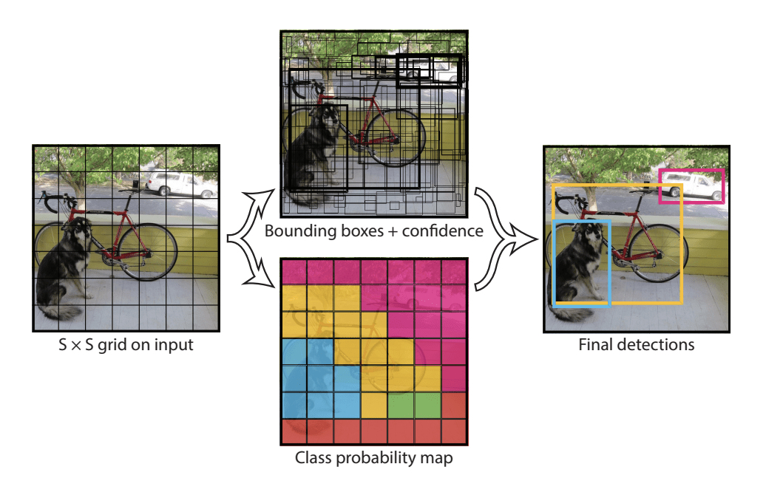
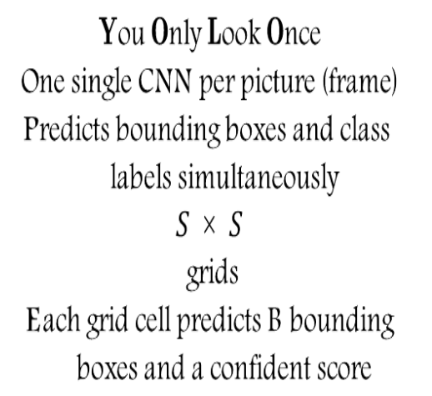
2. What is YOLO?
$$You Only Look Once$$
$$One single CNN per picture (frame)$$
$$Predicts bounding boxes and class$$
$$labels simultaneously$$
$$S \text{×} S$$
$$grids$$
$$Each grid cell predicts B bounding$$
$$boxes and a confident score$$
YOLO Architecture [1]

Slide 5
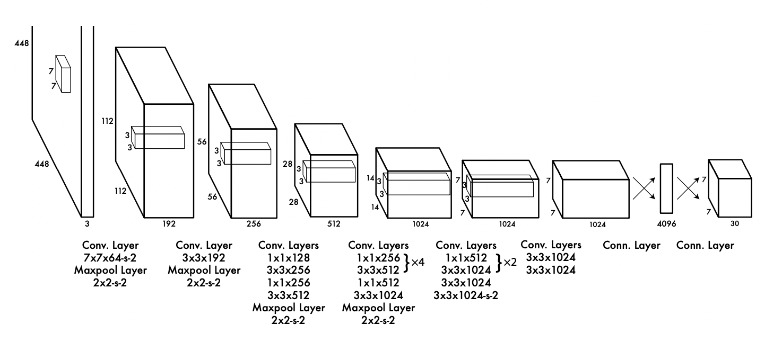
2. What is YOLO?
YOLO Architecture [1]

Slide 6
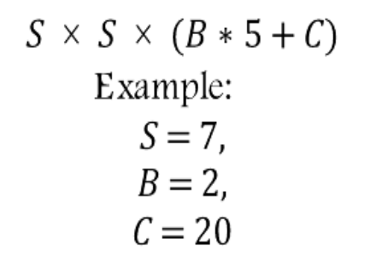
2. What is YOLO?
$$S \text{×} S \text{×} (B∗5+C)$$
$$Example:$$
$$S=7,$$
$$B=2,$$
$$C=20$$
YOLO Architecture [1]

Slide 7
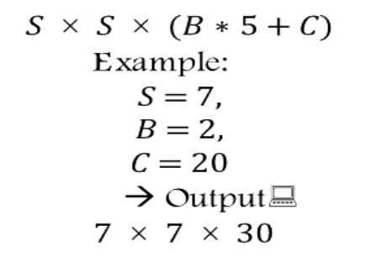
2. What is YOLO?
$$S \text{×} S \text{×} (B∗5+C)$$
$$Example:$$
$$S=7,$$
$$B=2,$$
$$C=20$$
$$→ Output:$$
$$7 \text{×} 7 \text{×} 30$$
YOLO Architecture [1]

Slide 8
2. What is YOLO?
$$S \text{×} S \text{×} (B∗5+C)$$
$$Example:$$
$$S=7,$$
$$B=2,$$
$$C=20$$
$$→ Output:$$
$$7 \text{×} 7 \text{×} 30$$
YOLO Architecture [1]
$${pred}_{cell}=\left[C_{1},C_{2},…,C_{20},p_{c1},x,y,w,h,p_{c2},x,y,w,h\right]$$
20 different classes
Box1
Box2

Slide 9
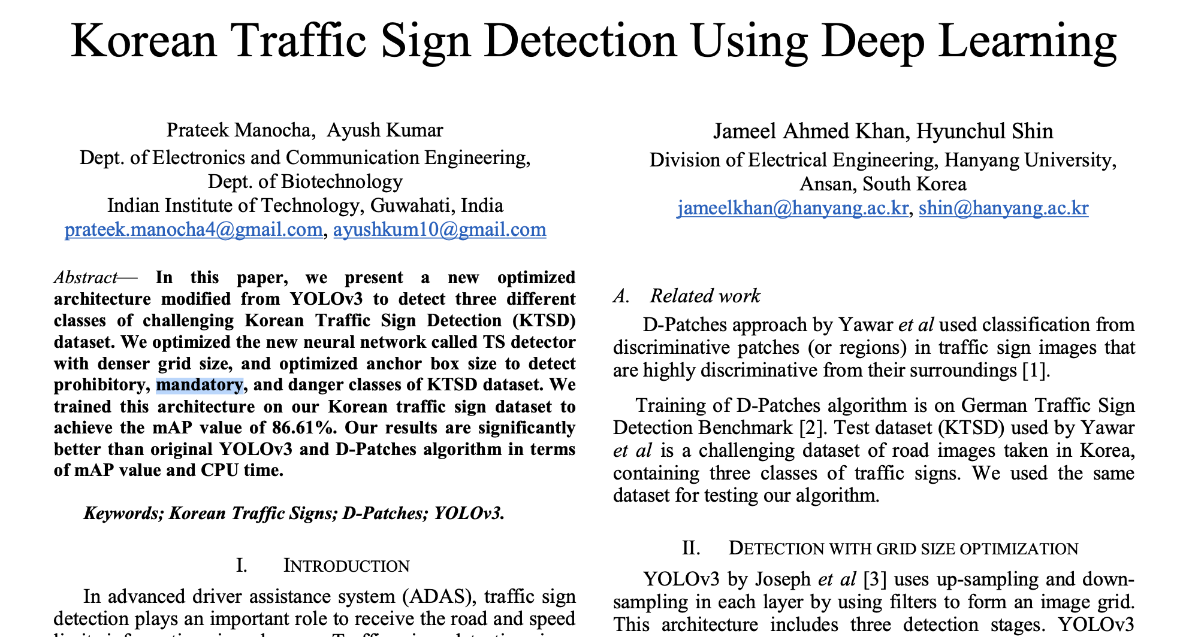
3. Reference Paper
https://ieeexplore.ieee.org/document/8649887
Notes:
https://ieeexplore.ieee.org/document/8649887
이 논문을 참조했음

Slide 10
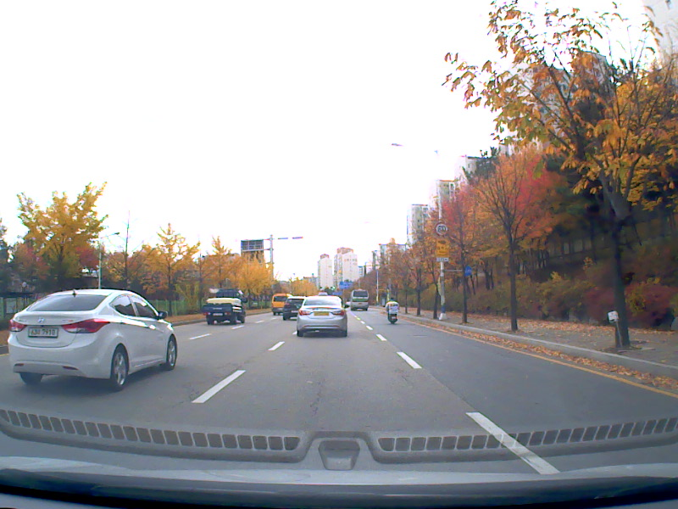
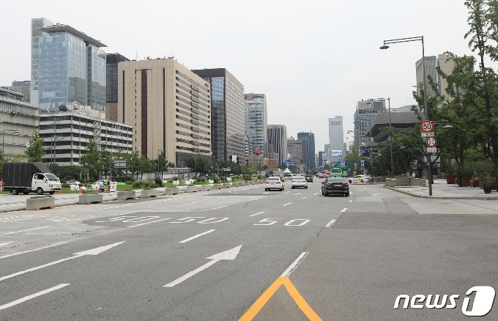
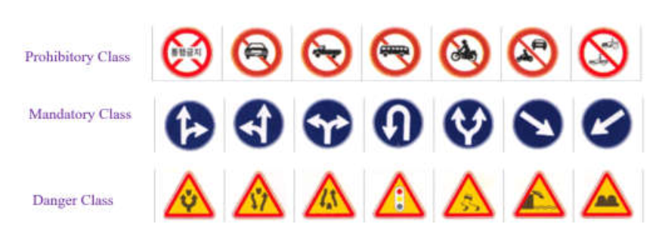
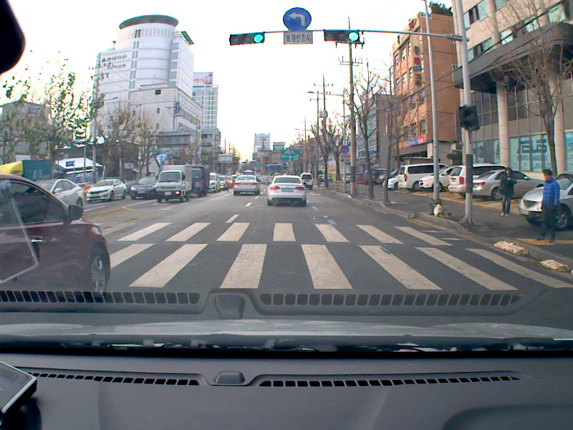
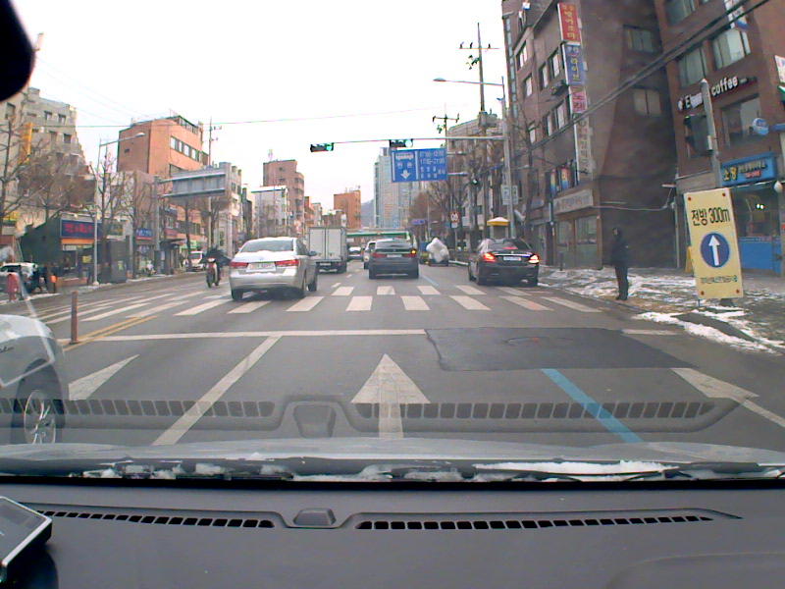
3. Reference Paper
Korean Traffic Sign Dataset
Korean Traffic Sign Classes
Training

Slide 11
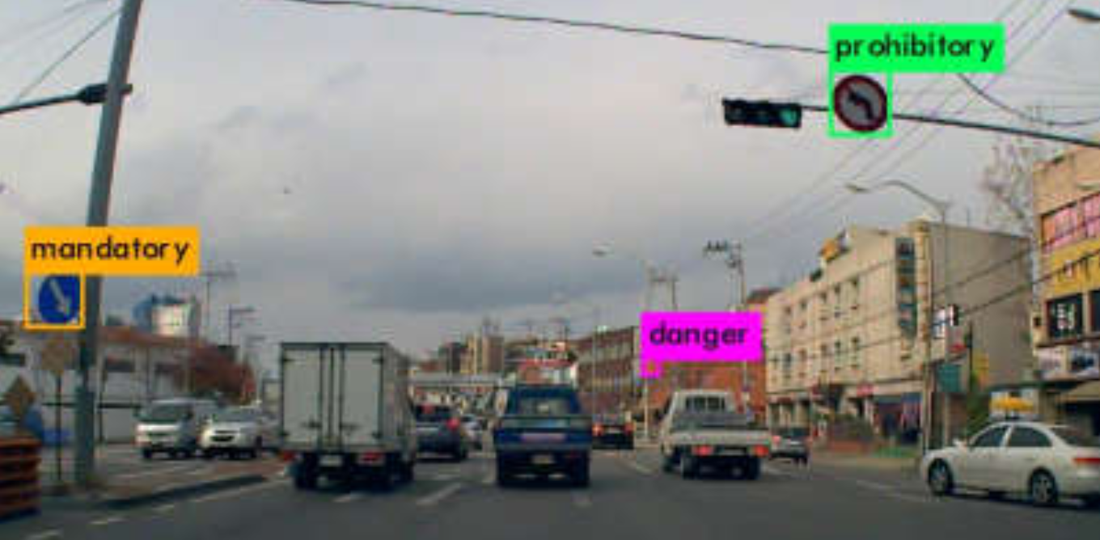
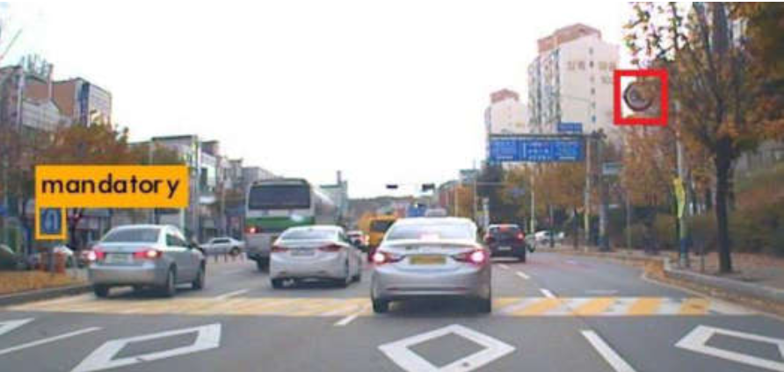
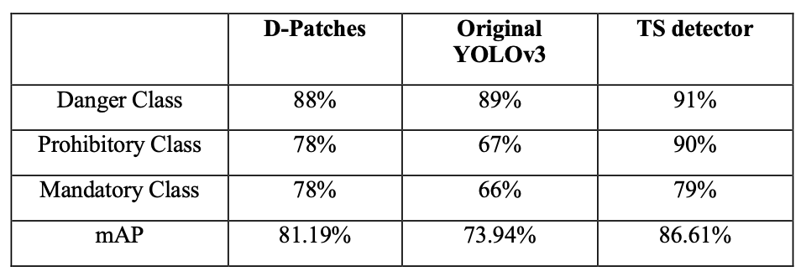
3. Reference Paper

Slide 12

3. Reference Paper
Korean Traffic Sign Dataset
Korean Traffic Sign Classes
Training with .

Slide 13









4. Data labeling
Software for labeling: LabelIMG
Supports YOLO
Coded in Python
Yolo is a supervised learning algorithm -> the data must be labeled
3 Different Classes of street Signs: prohibitory, mandatory and danger
prohibitory
mandatory
danger
Notes:
https://hc.hanyang.ac.kr/web/dslab/dataset?p_p_id=20&p_p_lifecycle=0&p_p_state=normal&p_p_mode=view&p_p_col_id=column-1&p_p_col_count=1&_20_struts_action=%2Fdocument_library%2Fview&_20_folderId=365651

Slide 14
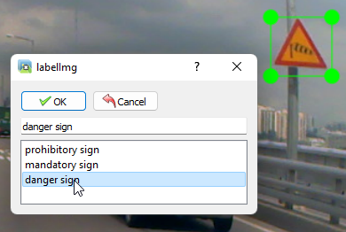
4. Data labeling
Data is being labeled by manually drawing boundary boxes around the street signs and assigning the class
Box coordinates and class is saved into a .txt file
Two datasets:
First Dataset was provided by Digital Systems Lab of Hanyang University: 500 pictures
Second Dataset taken from driving video on YouTube: 500 pictures
labeling

Slide 15
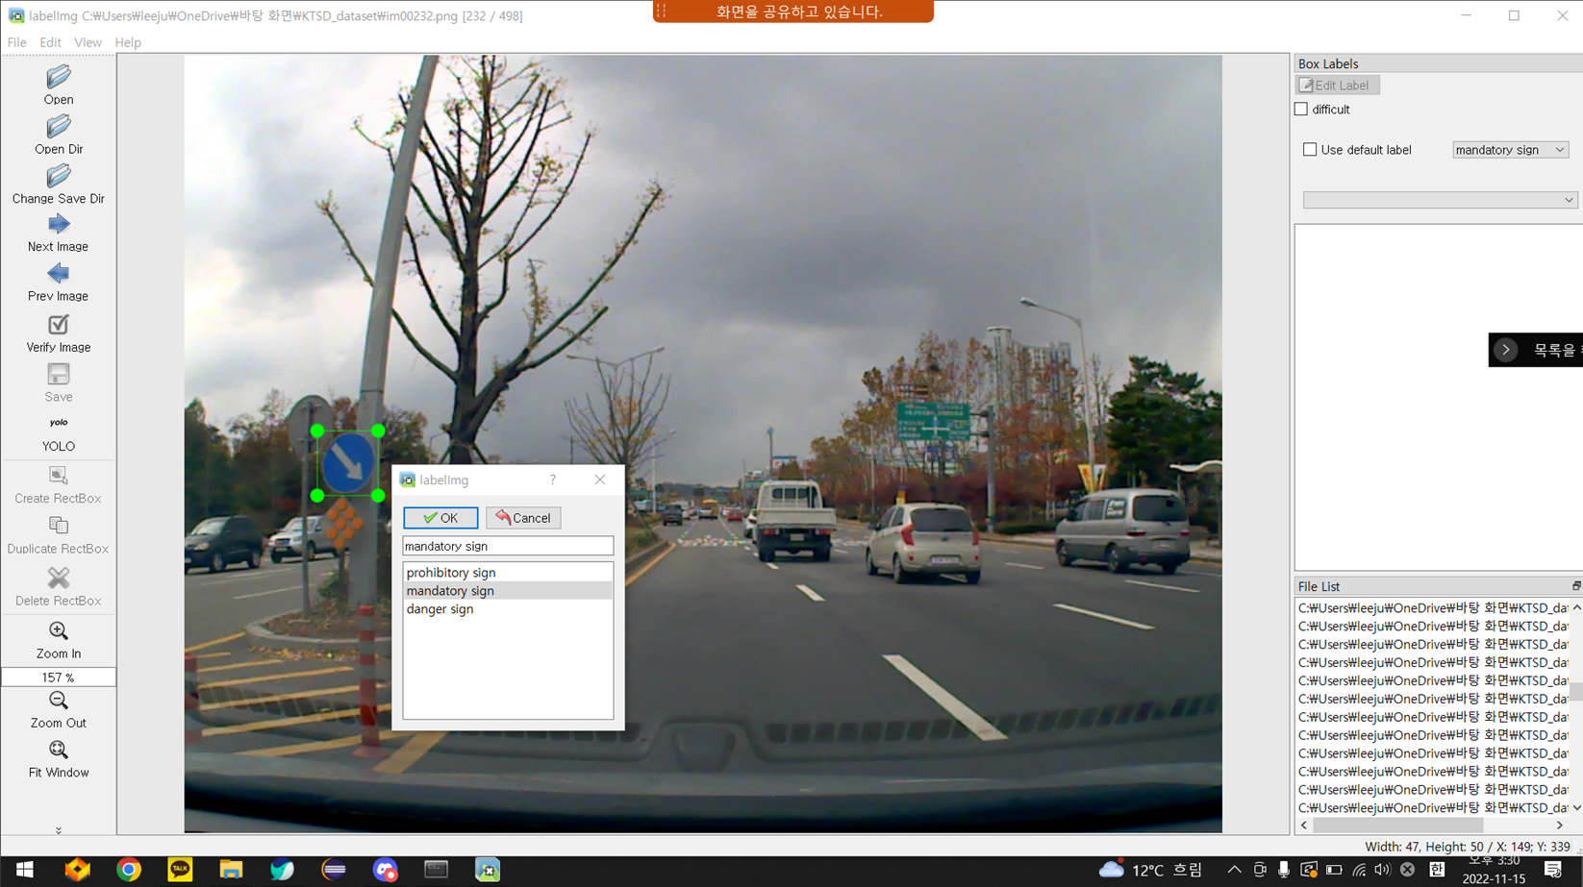
4. Data labeling

Slide 16
5. Implementation
core code

Slide 17
6. Result
accuracy

Slide 18
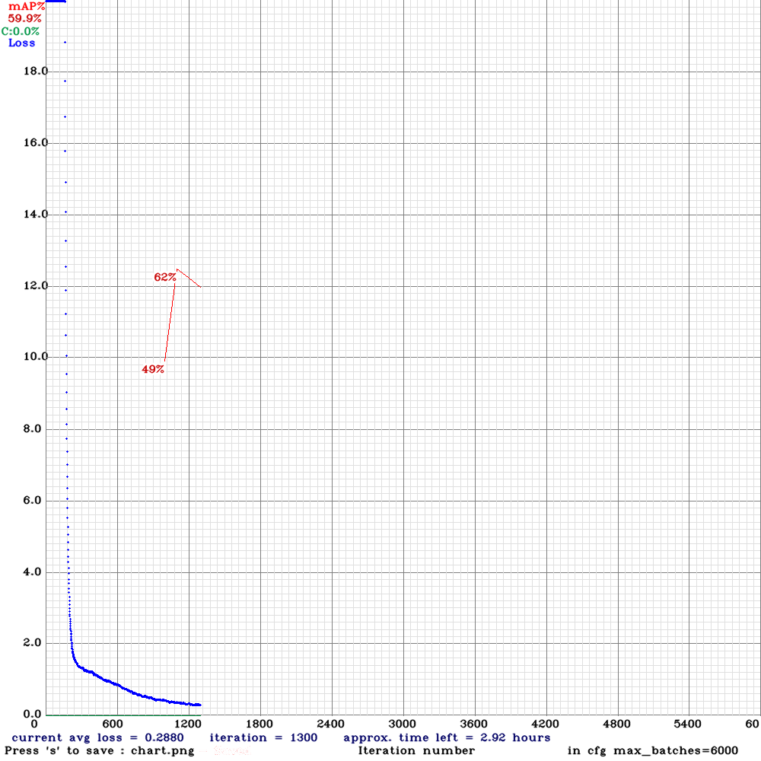
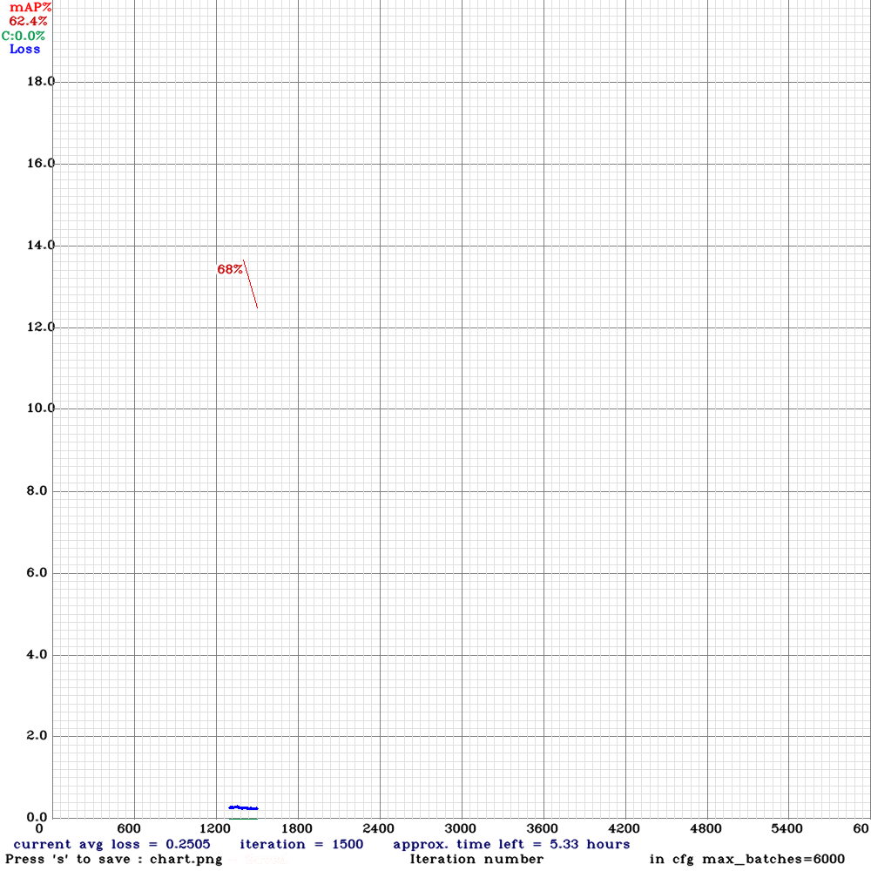
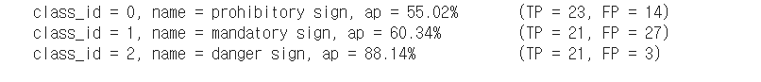
500 data, 1500 training on yolo tiny
X : Training number
Y : Loss (Blue line)
Red number : Accuracy
Accuracy for each class

Slide 19
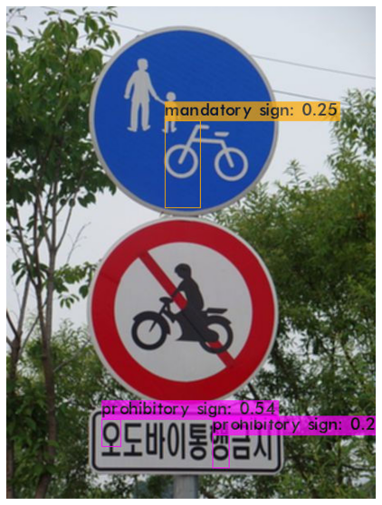
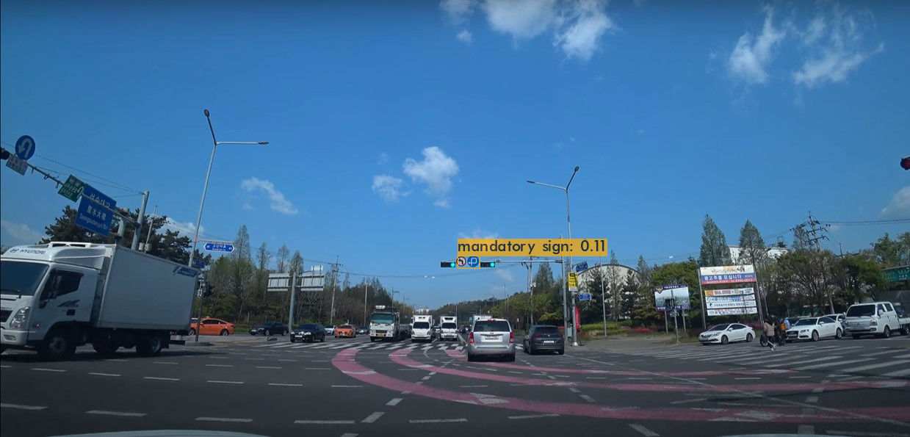
500 data, 1500 training on yolo tiny, threshold 0.1
Tested on image
Threshold 0.1 : Don’t show bounding box with probabilities less than 0.1
Result is not so good on images -> Need more data and training

Slide 20
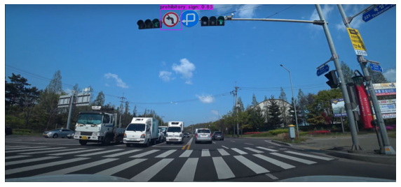
500 data, 1500 training on yolo tiny, threshold 0.1

Slide 21
Sources
https://ieeexplore.ieee.org/document/8649887
[1] J. Redmon, S. Divvala, R. Girshick, and A. Farhadi. You only look once: Unified, real-time object
detecotion. arXiv preprint arXiv:1506.02640, 2015.

